Slide 1

Checkpoint :
Introduction to Databases
Rimel Jabnoun

Slide 2
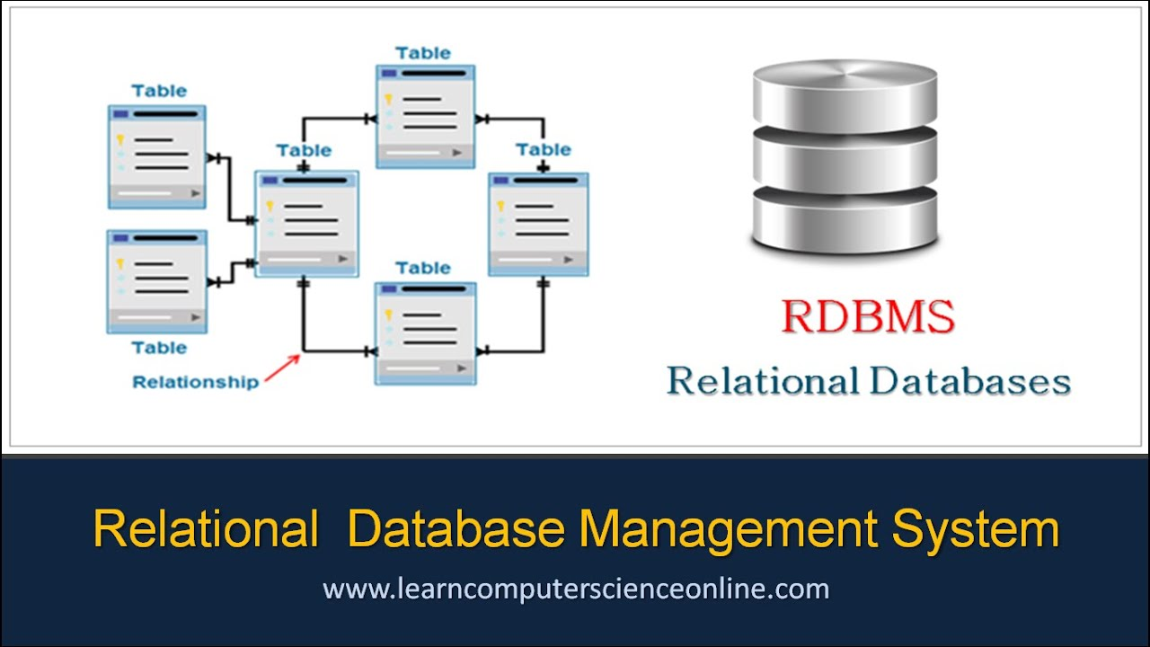
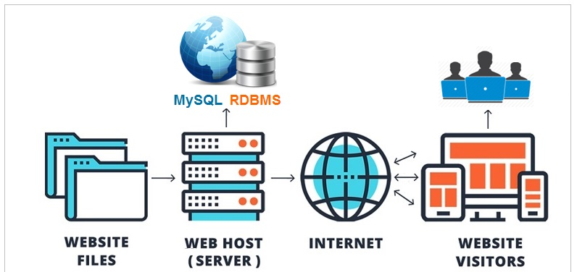
1) What is RDBMS?
An RDBMS is simply the set of software tools used to actually implement, manage, and query such a database or otherwise interact with a relational database.
RDBMSes store data in the form of tables, with most commercial relational database management systems using Structured Query Language (SQL) to access the database.
It provides a dependable method of storing and retrieving large amounts of data while offering a combination of system performance and ease of implementation.
In this presentation we are going to discover 3 RDBMS : MySQL, PostgreSQL and SQL SERVER .

Slide 3

2) What is MySQL?
MySQL is a relational database management system (RDBMS) developed by Oracle that is based on structured query language (SQL).
MySQL is integral to many of the most popular software stacks for building and maintaining everything from customer-facing web applications to powerful, data-driven B2B services.
In this model, tables consist of rows and columns, and relationships between data elements all follow a strict logical structure.
Its open-source nature, stability, and rich feature set, paired with ongoing development and support from Oracle, have meant that internet-critical organizations such as Facebook, Flickr, Twitter, Wikipedia, and YouTube all employ MySQL backends.

Slide 4
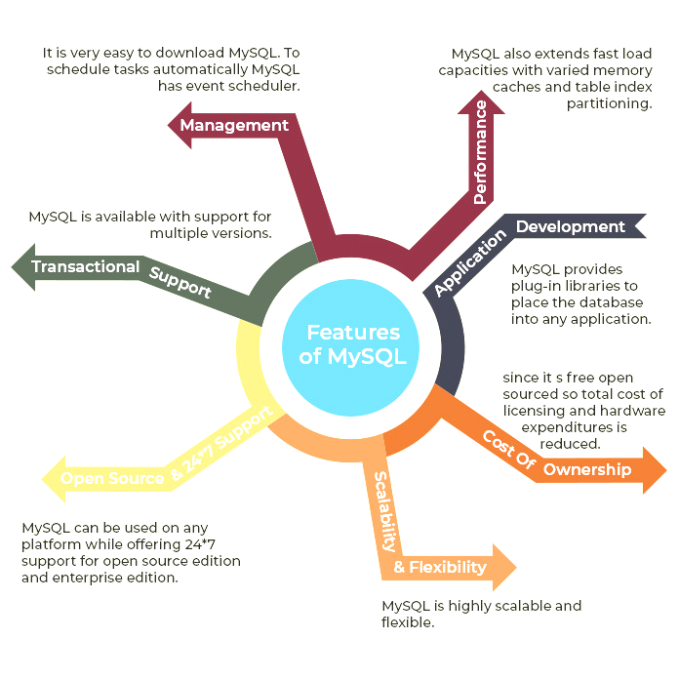
3) MySQL functionalities?

Slide 5

4) What is PostgreSQL ?
PostgreSQL is a powerful, open source object-relational database system that uses and extends the SQL language combined with many features that safely store and scale the most complicated data workloads.
PostgreSQL comes with many features aimed to help developers build applications, administrators to protect data integrity and build fault-tolerant environments, and help you manage your data no matter how big or small the dataset. In addition to being free and open source, PostgreSQL is highly extensible.
For example, you can define your own data types, build out custom functions, even write code from different programming languages without recompiling your database.
Used by organisation such as Skype, Yahoo, Myspace.

Slide 6
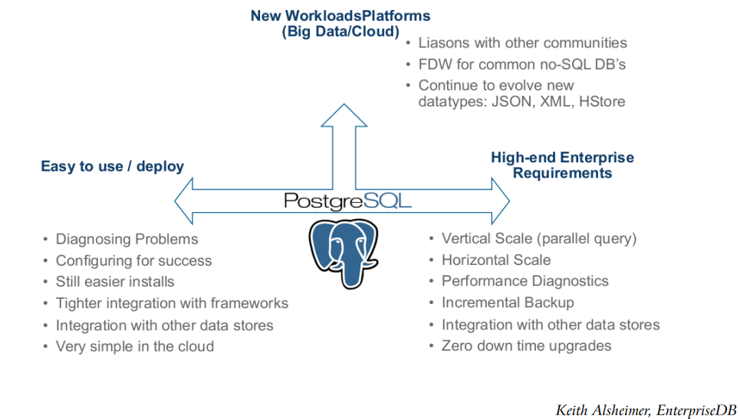
5) PostgreSQL functionalities ?

Slide 7
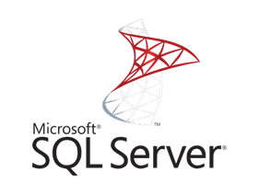
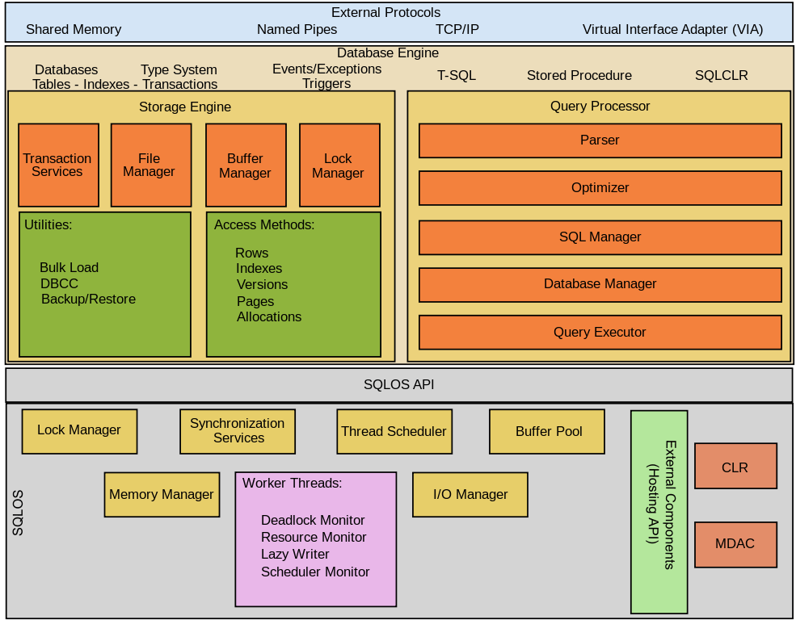
6) What is SQL SERVER ?
SQL Server is a RDBMS, developed and marketed by Microsoft. SQL Server is built on top of SQL, a standard programming language for interacting with the relational databases. SQL server is tied to Transact-SQL, or T-SQL, the Microsoft’s implementation of SQL that adds a set of proprietary programming constructs.
SQL Server consists of two main components:
1) Database Engine: consists of a relational engine that processes queries and a storage engine that manages database files, pages, pages, index…
2) SQLOS: provides many operating system services such as memory and I/O management. Other services include exception handling and synchronization services.

Slide 8
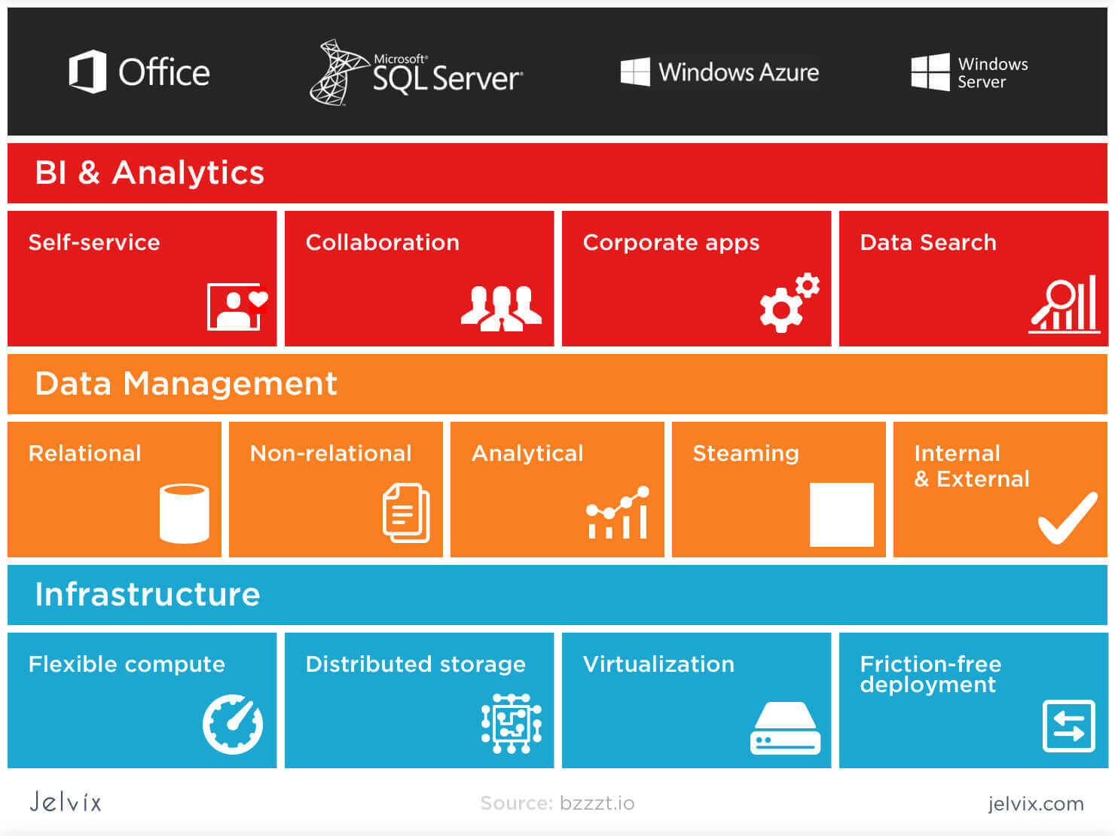
7) SQL SERVER functionalities ?

Slide 9
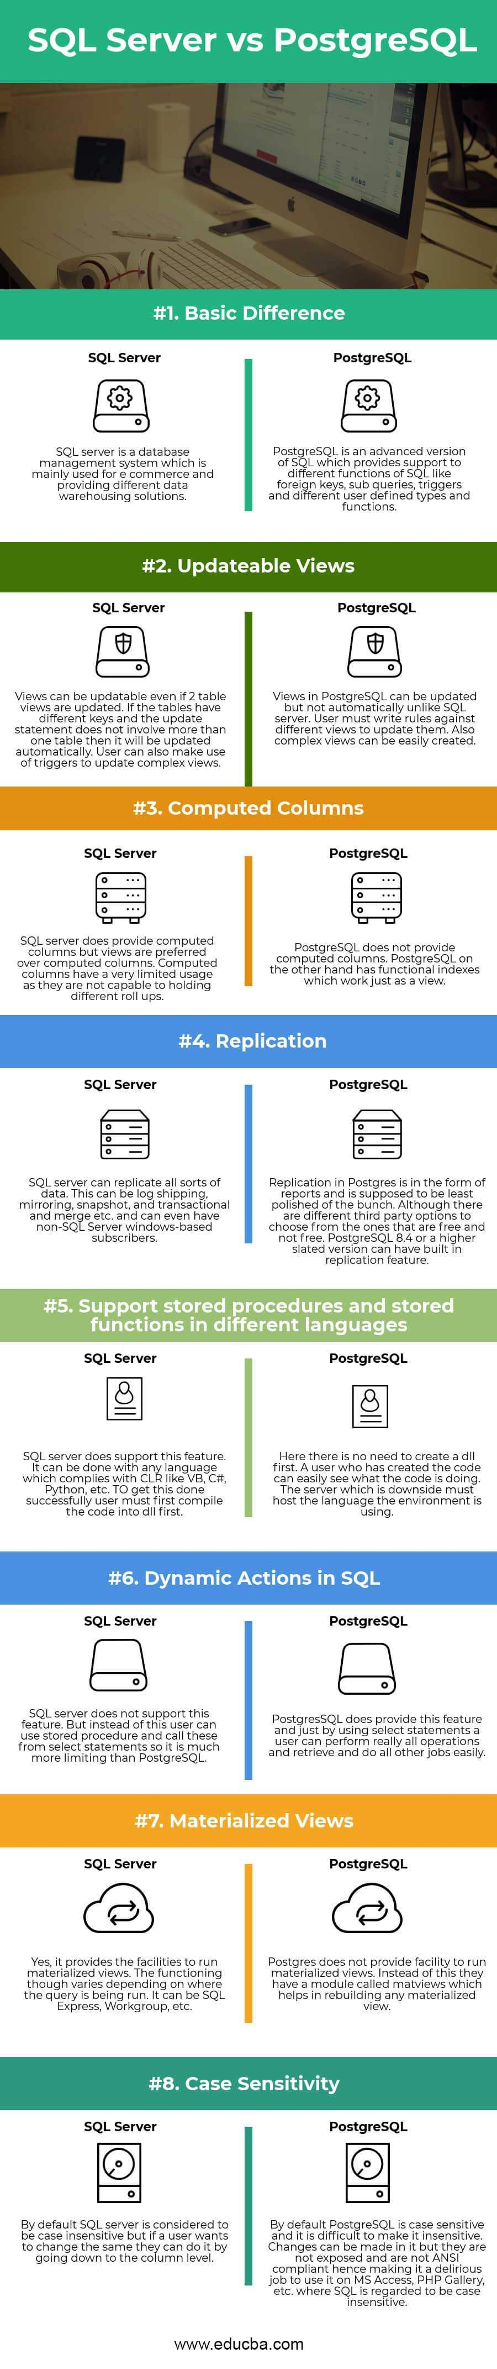
8) comparaison:

Slide 12
 | PostgreSQL | MySQL
Architecture | Extensible object-relational database management system; multiprocess | Relational database management system; single process
Performance | High-performance in situations requiring high read and write speeds | High-performance in web-based applications and situations requiring high read speeds
ACID compliance | ACID compliant | Only certain storage engines are ACID-compliant
Security | Native SSL support | TLS support
SQL:2016 conformance | Largely SQL-conformant; meets 160 out of 179 mandatory features | Partially SQL-conformant
Programming language support | Written in C; supports C/C++, Python, JavaScript, R, Delphi, Java, Tcl, Go, Lisp, Erlang, and .Net | Written in C and C++; supports C/C++, R, Delphi, Java, Go, Lisp, Erlang, PHP, Perl, and Node.js
Replication | Asynchronous, cascade, and synchronous | Asynchronous, synchronous, and semi-synchronous
Fault tolerance | Master-slave configurations, synchronous replication, and clustering | Master-slave configurations and clustering
Community support | Active, open source community with access to free resources | Vendor-backed community with access to free resources; additional support offered with paid versions

